Slide 1
Clinical Decision Support Systems

Slide 2
Clinical Decision Support Systems
Outlines:
Definition
Categories of CDSS
System Architecture
Need for CDSS
Applications Areas
Disadvantages
Issues for success or failure
Challenges for implementation.

Slide 3
Definition
A clinical decision-support system is a computer program designed to help health professionals make clinical decisions.
Is a computer system that deals with clinical data or medical knowledge is intended to provide decision support.

Slide 4
Definition:
an interactive Expert system Computer Software, which is designed to assist physicians and other health professionals with decision making tasks such as diagnosing and designing the treatment plan for a disease
active knowledge systems in which they use two or more items of patient data to generate case specific advice

Slide 5
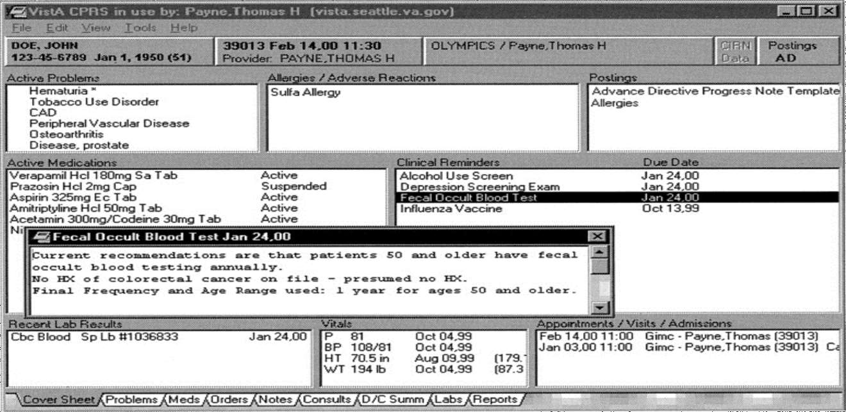
Examples of Successful Computer Decision Support Systems

Slide 6
Categories
Diagnostic assistance
Therapy critiquing and planning
Image recognition and interpretation

Slide 7
System architecture
Tools for information management
Tools for focusing attention
Patient specific consultation

Slide 8
1- Tools for Information Management
Examples:
Hospital information systems
Bibliographic retrieval systems (PubMed)
Specialized knowledge-management workstations (e.g. electronic textbooks, …)
These tools provide the data and knowledge needed, but they do not help to apply that information to a particular decision task (particular patient)

Slide 9
2- Tools for Focusing Attention
Examples:
Clinical laboratory systems that flag abnormal values or that provide lists of possible explanations for those abnormalities.
Pharmacy systems that alert providers to possible drug interactions or incorrect drug dosages.
Are designed to remind the physician of diagnoses or problems that might be overlooked.

Slide 10
3- Tools for Patient-Specific Consultation
Provide customized assessments or advice based on sets of patient-specific data:
Suggest differential diagnoses
Advice about additional tests and examinations
Treatment advice (therapy, surgery, …)

Slide 11
Characterizing Decision-Support Systems
System function
Determining what is true about a patient (e.g. correct diagnosis)
Determining what to do (what test to order, to treat or not, what therapy plan …)
The mode for giving advice
Passive role (physician uses the system when advice needed)
Active role (the system gives advice automatically under certain conditions)

Slide 12
Passive Systems
The user has total control:
Requires advice
Analyses the advice
Accepts/Rejects the advice
Domain of use:
Wide domain like internal medicine
Examples: QMR, DXPLAIN
Narrow domain
Acute abdominal pain
Analysis of ECG

Slide 13
Active Systems
The user has partial control
System gives advice
User evaluates the advice
The user accepts/rejects the advice
Domain of use
Limited domain
Drug interactions
Protocol conformance control
Laboratory results warnings
Medical devices control

Slide 14
Need for CDSS
Limited resources - increased demand, Physicians are overwhelmed.
Insufficient time available for diagnosis and treatment.
Need for systems that can improve health care processes.

Slide 15
Possible Disadvantages of CDSS
Changing relation between patient and the physician
Limiting professionals’ possibilities for independent problem solving
Legal implications - with whom does the responsibility lie?

Slide 16
Challenges to Implementation of CDSS
Clinical challenges:
No clinical database stores all information that is self sufficient or complete
Computers can assist but can’t replace human
Lack in integration of components of CDSS
Deficiency in planning for how the clinician will actually use the product in situation
CDSSs that are aimed at the diagnostic tasks have found success but are often very limited in utilization and scope
17

Slide 17
2. Technical challenges:
difficulty in incorporating the extensive quantity of clinical research being published on an ongoing basis
Biological systems are complicated, and a clinical decision may utilize an enormous data
3. Cost and Evaluation:
Different CDSSs serve for purposes, there is no common
different method
which applies to all such systems
18

Slide 18
4. Alert fatigue:
When clinicians are exposed to too many clinical decision support alerts they may eventually stop responding to them.
The alert was not serious, was irrelevant, or was shown repeatedly
19

Slide 19
Approach to overcome challenges
To increase user acceptance
By motivation, training and education of the clinical &
non clinical staff for using the system.
Developing better user interfaces. This could be done by involving the user at the design stage. Keeping their needs and desires in mind the system should be developed.
Convenience of the end user should be kept in mind at designing stage.
Constraints under which the user works should be
considered at this stage.
Cost utility analysis.
20

Slide 20
Criteria for a clinically useful DSS
Knowledge based on best evidence
Knowledge fully covers problem
Knowledge can be updated
Data actively used drawn from existing sources
Performance validated thoroughly

Slide 21
Criteria for a clinically useful DSS (cont.)
System improves clinical practice.
The system is easy to use.
The decisions made are transparent.

Slide 22
TYPES OF CLINICAL DECISION SUPPORT
There are two main types of CDSS:
Knowledge-Based CDSS
2. Non-Knowledge-Based CDSS
a) Artificial neural networks
b) Genetic algorithms

Slide 23
Knowledge-Based CDSS
Most CDSS consist of three parts, the knowledge base, inference engine, and mechanism to communicate.
• The knowledge base contains the rules and associations of compiled data which most often take the form of IF-THEN rules. If this was a system for determining drug interactions, then a rule might be ,for example
• IF drug X is taken AND drug Y is taken THEN alert user. In such a way using another interface, an advanced user could edit the knowledge base to keep it up to date with new drugs.
• The inference engine combines the rules from the knowledge base with the patient’s data.
• The communication mechanism will allow the system to show the results to the user as well as have input into the system

Slide 24
NON-KNOWLEDGE-BASED CDSS
• CDSS’s that do not use a knowledge base, but use a form of artificial intelligence called machine learning, which allow computers to learn from past experiences and/or find patterns in clinical data.
• Two types of non-knowledge-based systems are
• artificial neural networks and
• genetic algorithms.

Slide 25
EXAMPLES OF CDSS
Zynx Health – the most prominent organization in the CDSS marketplace, whose CDSS is linked to a statistically significant percentage of hospital discharges nationwide
MYCIN, one of the first expert systems to be developed in the 1970s, it does ethiological diagnoses of bacterial diseases
CADUCEUS, a medical expert system that could diagnose 1000 diseases
Internist-I, is a rule-based expert system for solving complex diagnostic problems in general internal medicine
Dxplain, developed at Massachusetts General Hospital, uses a modified form of Bayesian logic to produce a ranked list of diagnoses that might explain or be associated with the clinical manifestations.

